Slide 1
Manageable Steps to Complete the Candidacy Exam
Rebecca Hill
Angelia Lomax
Andrea Garraway
Mark A Saunders Sr

Slide 2
What is the Candidacy Exam?
An electronic portfolio that:
contains artifacts and reproductions from each class in the CES program
serves as a self-assessment
Detailed information regarding the required contents of the portfolio are explained in the Candidacy Examination Portfolio Manual. Access to this manual is in the CES Center on Blackboard.

Slide 3
Why the Candidacy Exam Process Needs Manageable Steps Outlined
Map out the process into phases
Provide clear steps from start to submission
Alleviate anxiety related to this comprehensive project

Slide 4
Beginning Phase

Slide 5
Beginning Phase
Step 1: Read Manual
Step 2: Create a folder for each class
Label class folder with course number
In each folder include the syllabus and all graded work
The manual refers to these items as artifacts and reproductions
Step 3: Regularly save your work on an external hard drive! (may not be retrievable later)
Notes:
a. Artifacts - materials that are normally produced through coursework, clinical experiences, and professional development activities (e.g., research papers, conference presentation materials, course syllabi).
b. Reproductions - materials that reproduce actual practice (e.g., videotapes, audiotapes, verbatim transcripts).
c. Reflections - reflective statements that integrate explanations, development, and insights throughout an individual’s professional development. Reflection statements encourage individuals to consider their growth, professional challenges, learning within a personal and professional context, and the opportunity to consider professional identity on an individual basis.

Slide 6
Beginning Phase (cont’d)
Step 4: Create Leadership Competencies folder
Refer to list of 10 items in the manual
Begin independent leadership experiences
Add supporting documentation throughout program
(Examples: proof of ACA membership, certificate for attending conferences, leadership in organizations, confirmation of proposal submissions, etc.)

Slide 7
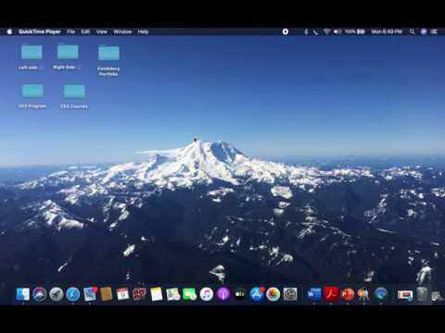
Video example of Beginning Phase

Slide 8
Middle Phase

Slide 9
Middle Phase
Step 1: Re-read the manual
Step 2: Create Six folders
5 for Each CACREP Doctoral Competency
1 for List of Leadership Counseling Competencies (10 listed in manual)

Slide 10
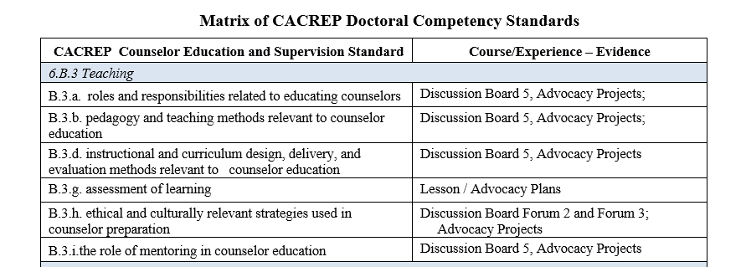
Middle Phase (cont’d)
Step 3: Distribute artifact or reproduction from course folders into appropriate CACREP Competency folder.
Pay attention to KPI/Capstone projects.
See CACREP Matrix
Notes:
Disseminate throughout the classes or do a little at a time. Having folders makes it easier to distribute. Organization. Maybe do it as you go.

Slide 11
Middle Phase
Step 4: Attach a rationale to each artifact and reproduction to explain how it demonstrates that competency
Step 5: Upload supporting documents into Leadership Competency folder showing proof of completion of each item

Slide 12
Video Example of Middle Phase

Slide 13
Final Phase

Slide 14
Final Phase
Step 1: Re-read the manual
Step 2: Write a reflection:
Using the four questions in Candidacy manual write a reflection of mastery for each of the five CACREP competencies and include in appropriate folder
Step 3: Refer to examples of completed Exam in Ph.D. CES Center
Step 4: Decide Electronic format
Digication, Weebly, Wix, Dropbox, ETC.

Slide 15
Final Phase (cont’d)
Step 5: Complete Candidacy Exam Checklist
Step 6: Identify Faculty Advisors (refer to acceptance letter)
Step 7: TURN IT IN!

Slide 16
Candidacy Exam Checklist
Candidacy Exam Checklist
1. ________ Read Candidacy Exam Manual in the Ph. D. CES center
2. ________ Make class folder with course number
3. ________ Save ALL class content, projects, and graded feedback in class folder
4. ________ Regularly back up computer to external hard drive
5. ________ Add personal reflection for each class folder noting professional
development
6. ________ Make 5 Folders: 1 for each CACREP doctoral competency
7. ________ Add a 6th Folder for Leadership Counseling Competencies (10 listed)

Slide 17
Candidacy Exam Checklist
7. ________ Add a 6th Folder for Leadership Counseling Competencies (10 listed)
8. ________ Open class folder and examine syllabus looking at the CACREP matrix
To determine where each assignment moves into one or more of the 5
CACREP doctoral competencies (cheat sheet for placing artifacts/reproductions
9. ________ In some way be sure every standard is represented for each of the 5
Doctoral competencies
10. ________ Write competency reflections (5 CACREP competencies)
11. ________ Write a reflection for each artifact and attach competency standard number
12. ________ Re-read the manual

Slide 18
Candidacy Exam Checklist
13. ________ Add at least one supporting document for the list of (10) Leadership
Counseling competencies
14. ________ Look at examples of other Candidacy Exams
15. ________ Submit Candidacy Exam to Academic Advisor

Slide 19
Implementation for Student Access
It is our intention that this information is placed into the Ph.D. CES Center for students.
Students can access desired information on blackboard by phases (beginning, middle, and final). Each phase will have its own folder within the Candidacy Exam module that includes the following: information from respective powerpoint slides, video demonstrations (Beginning Phase, Middle Phase), and link to Candidacy Exam Manual.

Slide 20
THANK YOU!

